Slide 1
Tutorial 2
Asep Trisna Setiawan
23221111

Slide 2
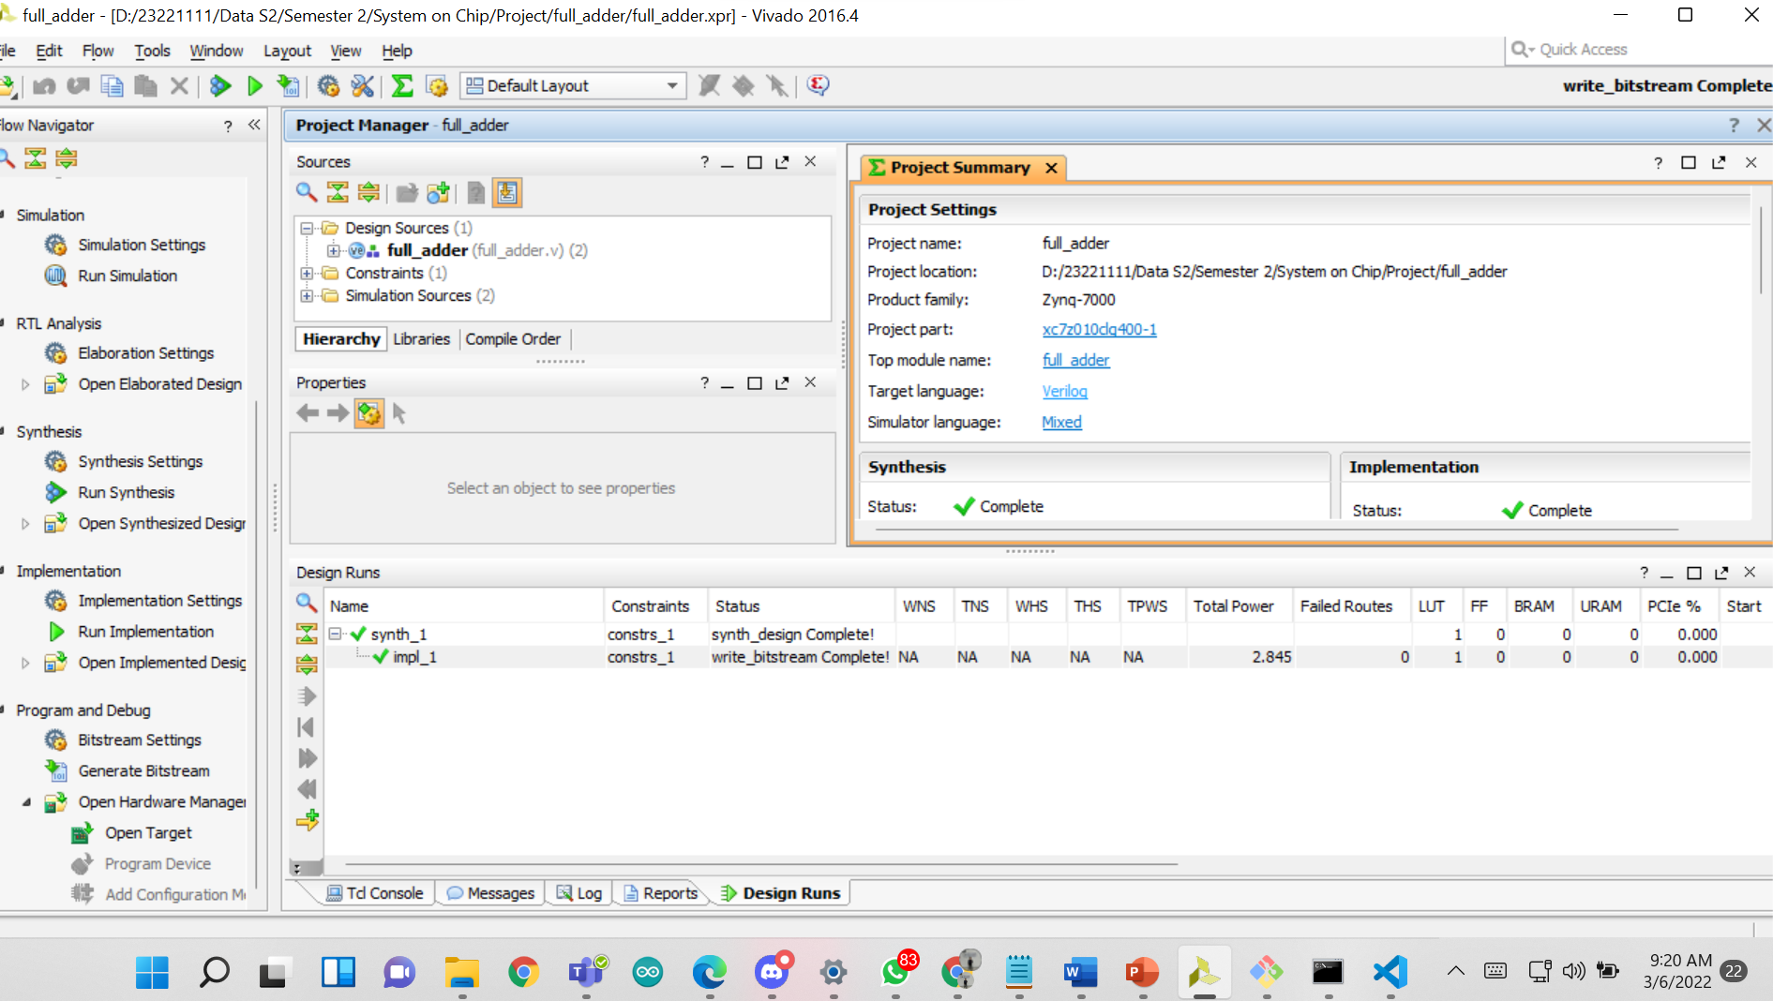
Lanjutan Tutorial Modul 1

Slide 3
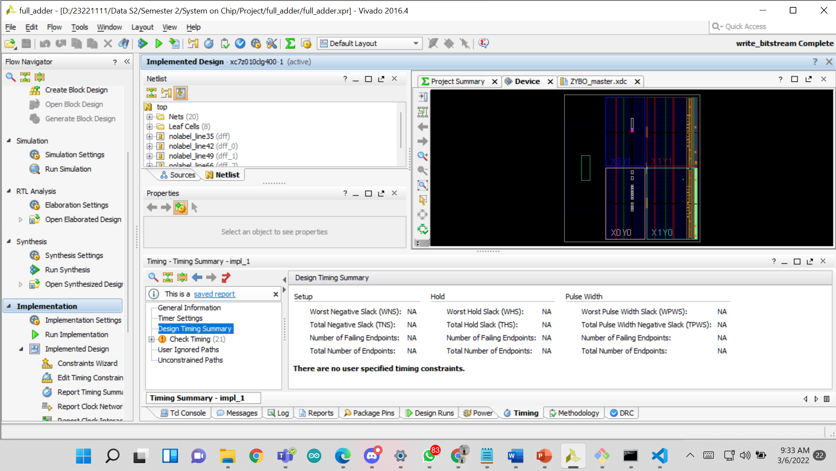
Open Implementated Design

Slide 4
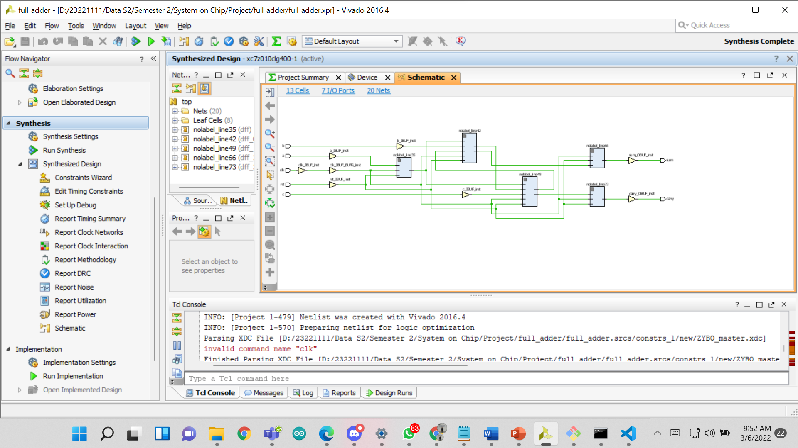

Slide 5
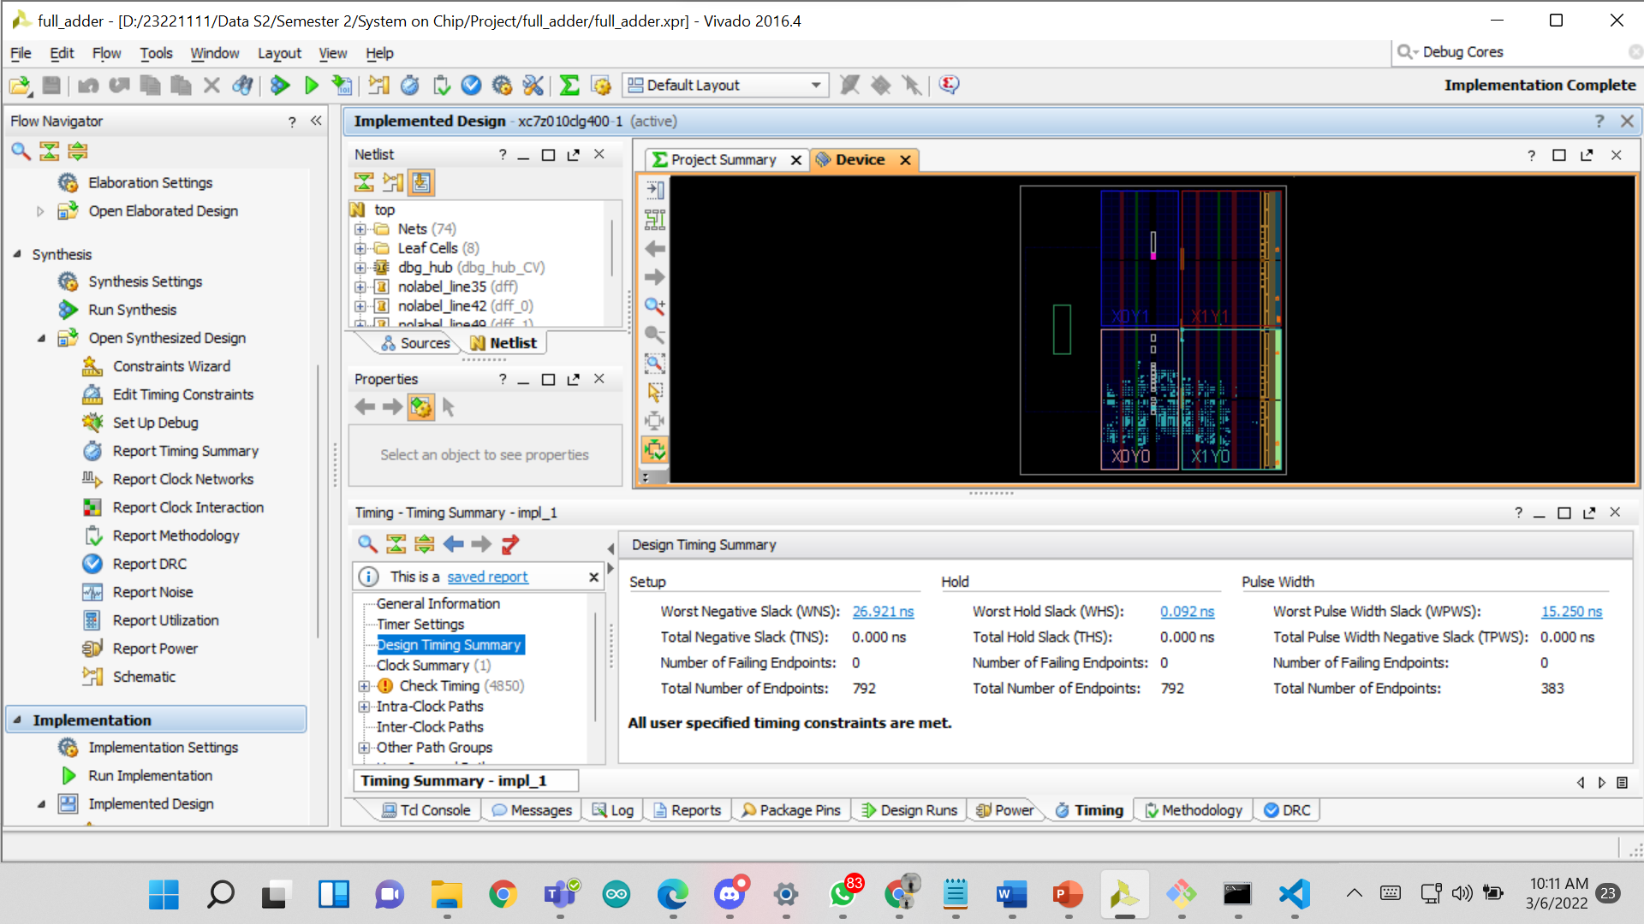

Slide 6
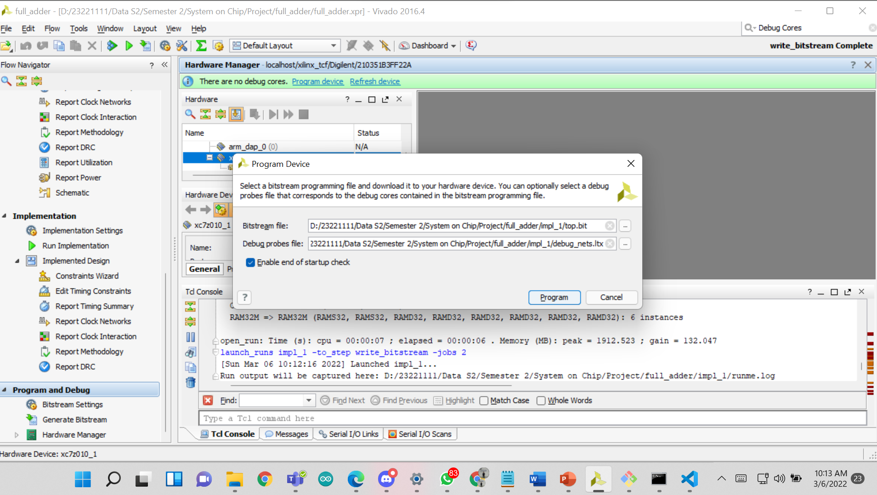

Slide 7
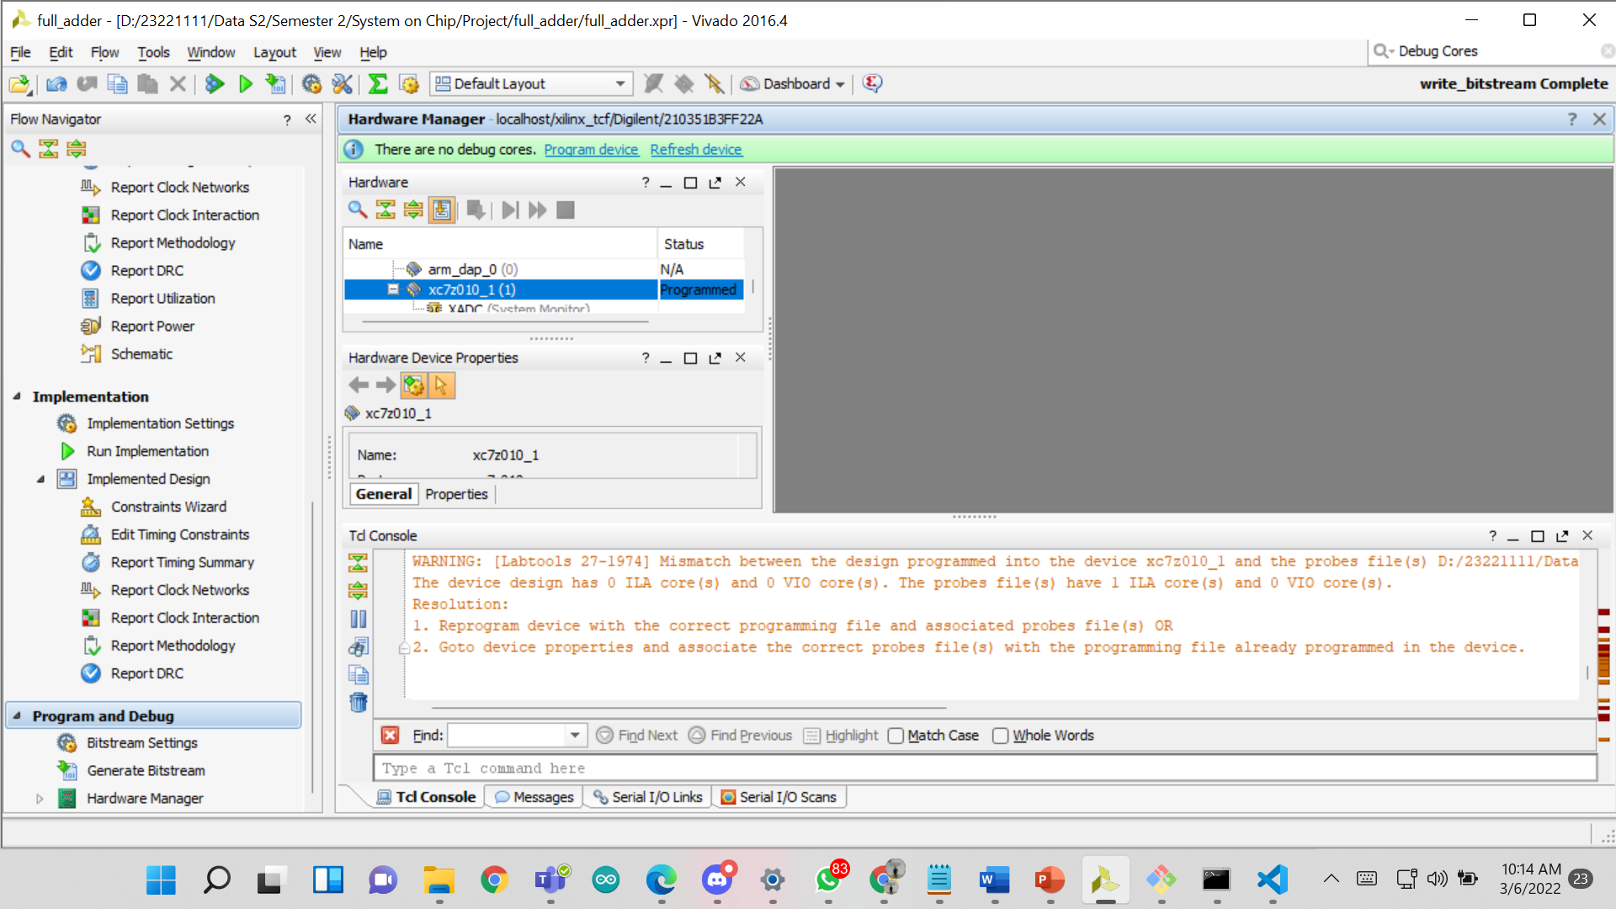

Slide 8
